Slide 1


Slide 2

Agenda
Refresher on FINEder - Who we are / What we do
Hypothesis
Data Preprocessing and Cleaning
Model Selection
Creating and fitting the model
Visualizations
Results

Slide 3
Refresher
FINEder is an app aimed at helping people and businesses across NYC predict and avoid the likelihood of receiving a high parking fine in a specific area
Our mission is to create a hassle-free journey for travelers, residents and coworkers. Our application safeguards individuals from parking violations in the city and at the same time avoids unnecessary clutters and traffic jams.
We plan to use NYC Parking Violation Data to predict how much a consumer or a business entity will be charged for incurring a parking violation.
https://www.kaggle.com/datasets/new-york-city/nyc-parking-tickets

Slide 4

Hypothesis
We hypothesize that the use of specific quantitative and qualitative variables in the NYC parking data set can be successful in predicting the likelihood of a user receiving a violation and the fine amount
These results can help our company develop insights on violations based on various criterias, to help our users avoid potential fines
The methodologies we tested on the 100,000 records were:
Naive Bayes
Random Forest
Decision Tree

Slide 5
Preprocessing
Original Dataset had 10,803,028 records.
Dropped irrelevant columns and Null Values, bringing total to 1,245,953
Found count of unique values for each column and used mapping to adjust any inconsistencies in spelling / category types. Unique values with very low counts were grouped together and mapped under “OTHER”
We created a new column to bin the time of violations. Converted the data to date-time object. We used categorized them by business hours (9am-5pm).
We also created a column to see what part of the month the violation occurred.
Beginning (1-10), Middle (Middle 11-20), End (21-end of month)
Then random sampled 100,000

Slide 6
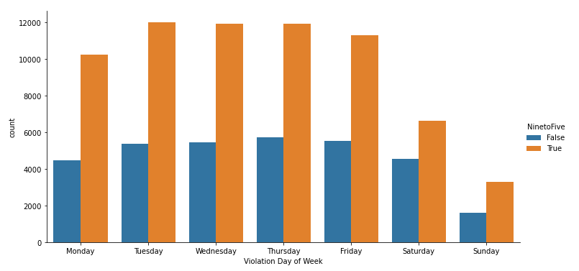
Data Visualization
*Based on 100,000 random records
Categorical Plot of the number of violations given per day. Orange bars represent tickets given during peak/working hours (9am-5pm) and blue represents off-peak hours (rest of the day)
Significantly more violations occur during peak hours, especially during a typical work week

Slide 7
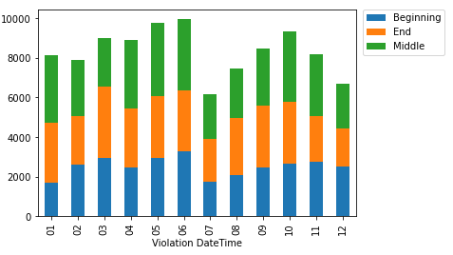
Data Visualization
*Based on 100,000 random records
Visualization of tickets given per month
Wanted to see if any outliers (month with significantly more or less tickets given)
June-July had a major dip in number of tickets
Remainder of the year fairly consistent with around 7,000+ tickets per month
Stacked it based on which portion of the month the violation occurred
Beginning of the month consistently lower

Slide 8
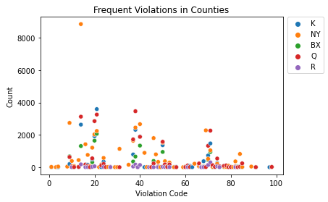
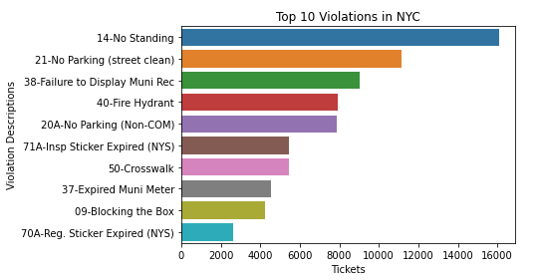

Data Visualization
*Based on 100,000 random records
Left: Scatter plot of the most frequent Violation Code by County.
Outlier:
Besides the one outlier, fairly consistent violations committed
Right: Top 10 Violations across NYC
Code 14 (No standing) significantly most violated
Only 2 of the Top 10 are time based violations

Slide 9
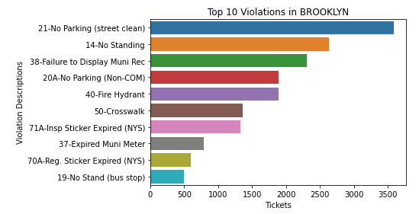
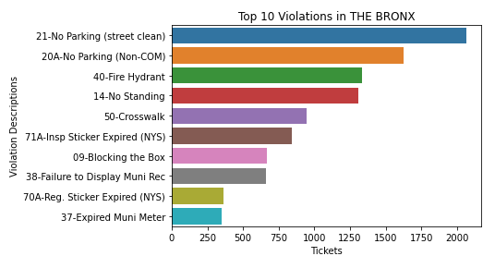
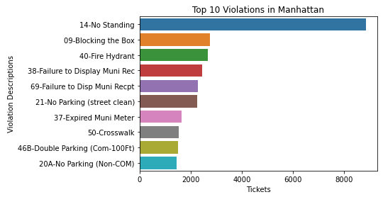
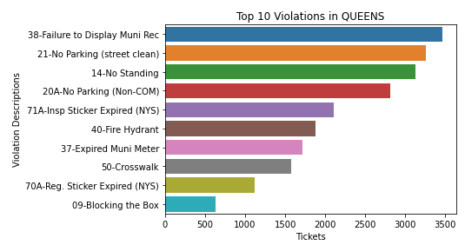
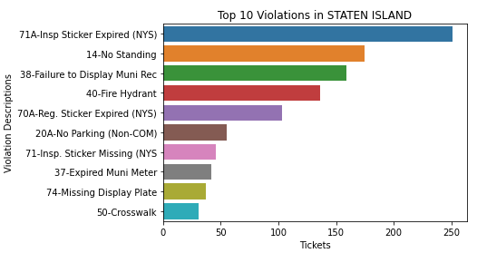

Slide 10
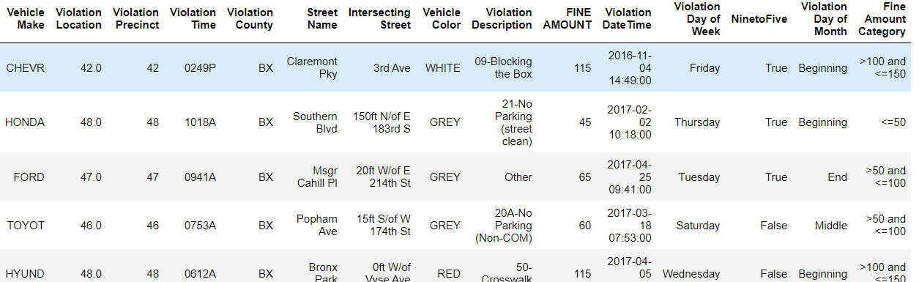
Manipulating Time

Slide 11
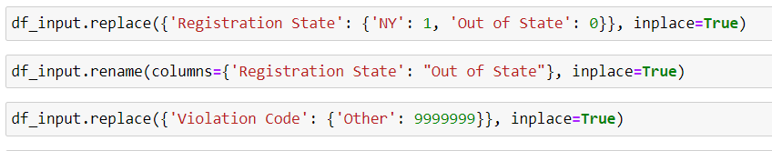
Formatting Columns

Slide 12
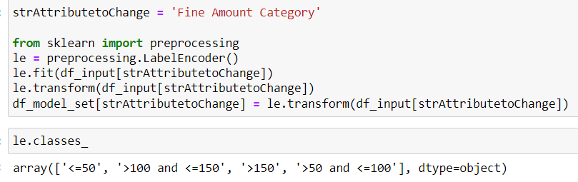
Binning Fine Amounts

Slide 13
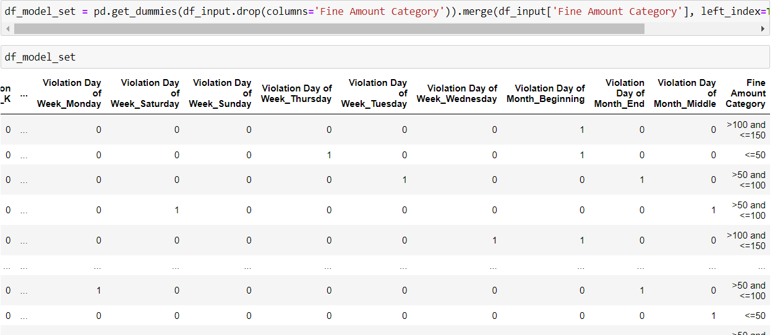
Dummy Variables

Slide 14
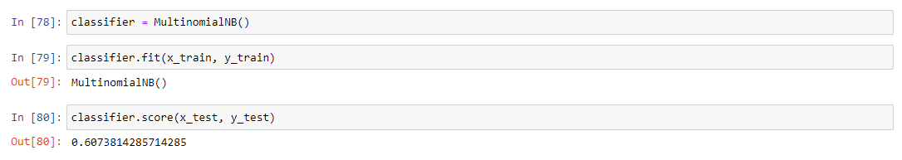
Naive Bayes (Milestone 2 Results)

Slide 15
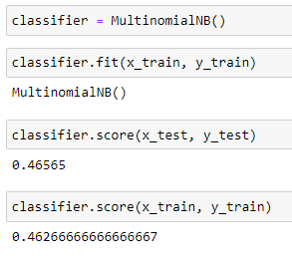
Naive Bayes Prediction Results

Slide 16
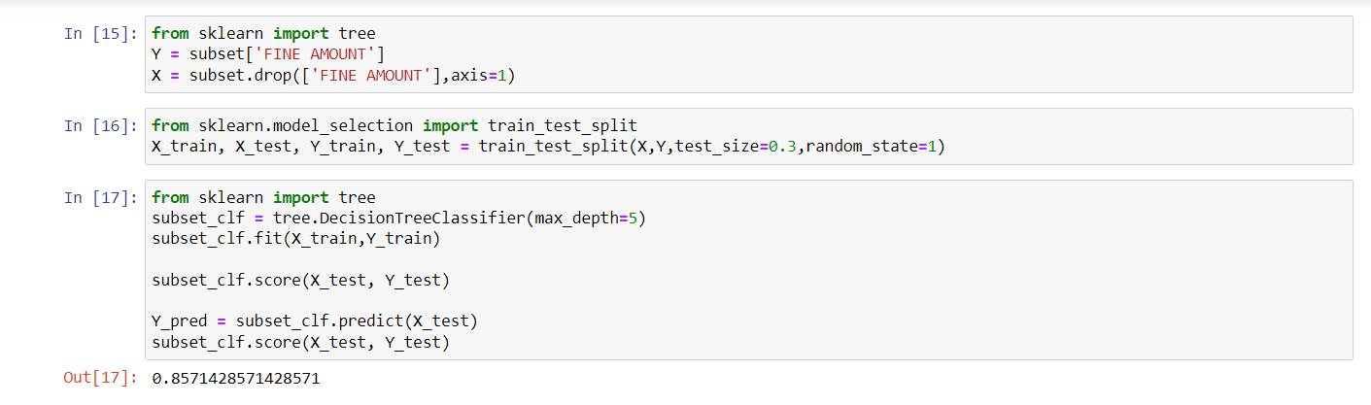
Decision Trees (Milestone 2 Results)

Slide 17
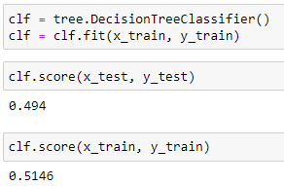
Decision Tree

Slide 18
Random Forests
WHAT IS IT ?
It’s a Machine Learning Algorithm that combines the output of multiple decision trees to reach a single result.
WHY DID WE USE IT ?
It can perform classification tasks
It can handle large datasets efficiently
It provides a higher level of accuracy in predicting outcomes over the decision tree algorithm.

Slide 19
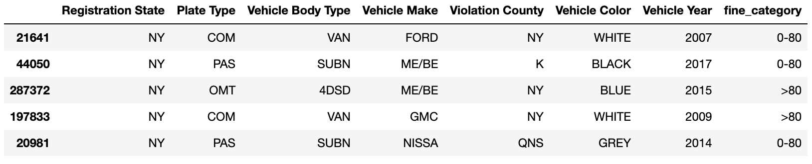
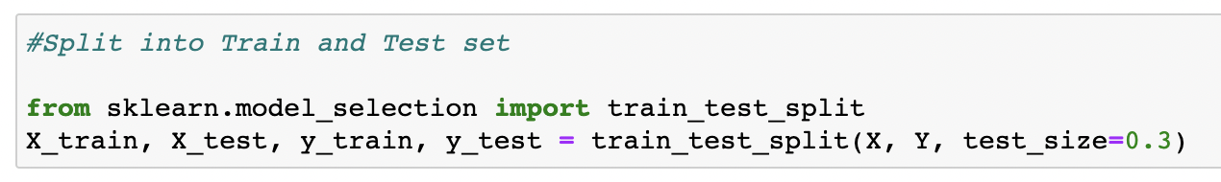
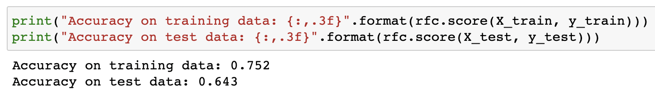
Categorized Fine Amount into 2 categories (0-80, >80).
Divided the sample into 70% Train set and 30% Test set

Slide 20
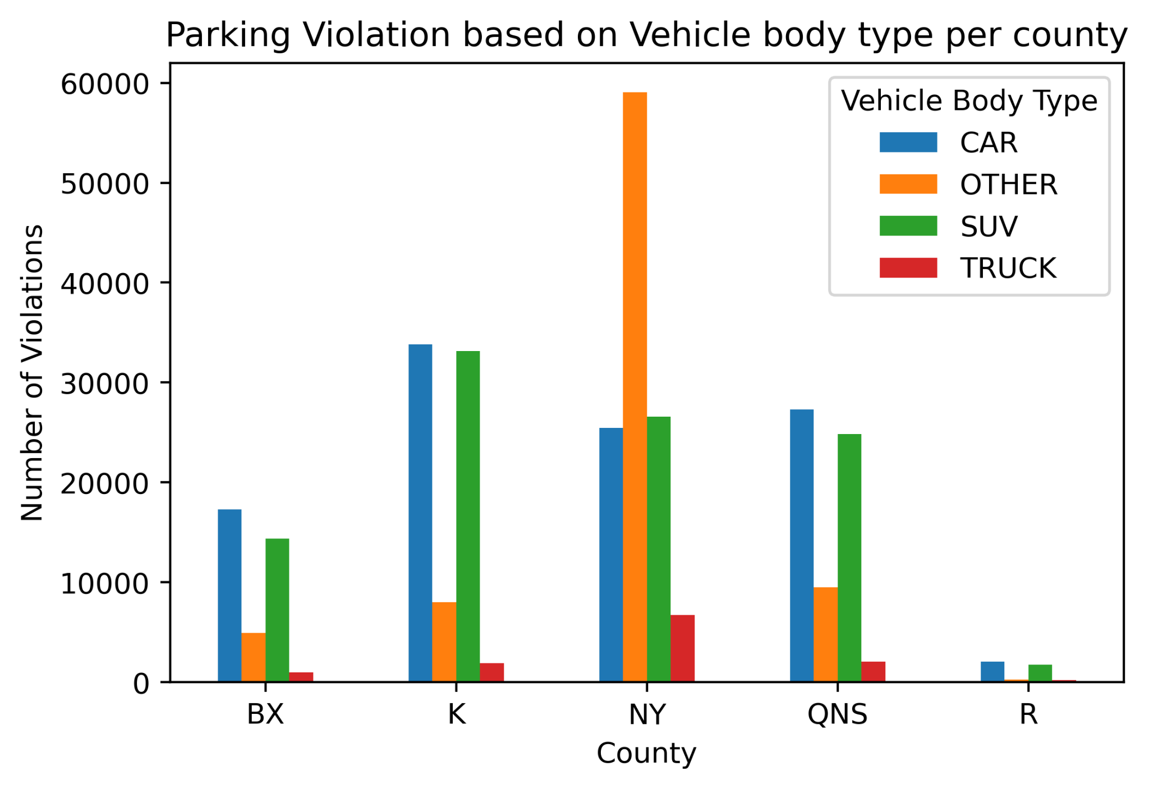
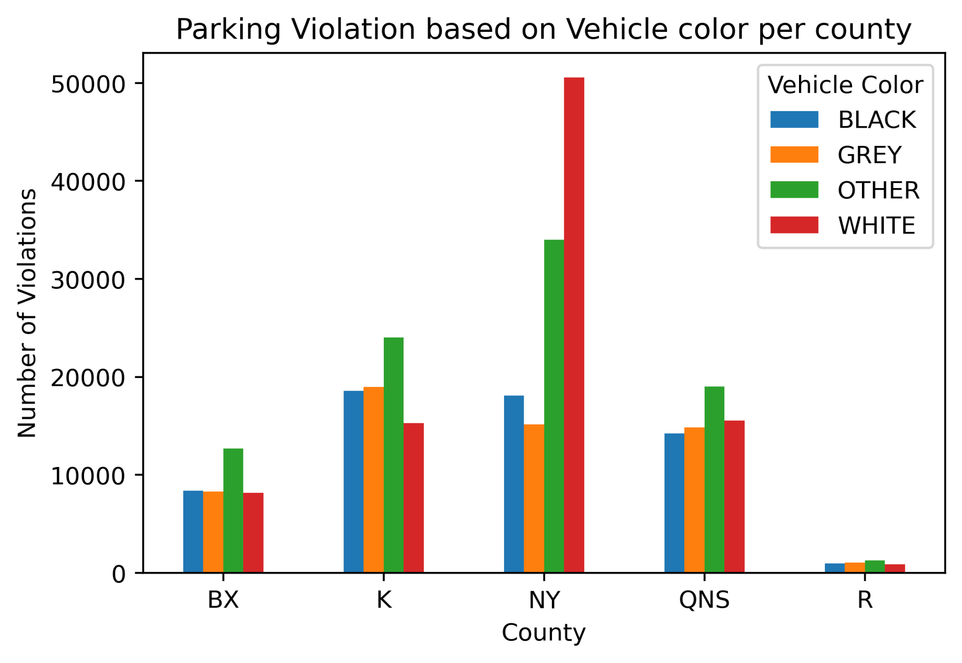
Visual Insights
The OTHER category in the Vehicle Body Type consists of Delivery vans/trucks
Approximately 20% of the violations were committed by Delivery vans/trucks in Manhattan itself
White cars receive more parking violations than any other car color in Manhattan
* Sample size = 300,000
* Sample size = 300,000

Slide 21

Summary and Final Thoughts
Based on our methods, the models produced lower scores compared to milestone 2
We believe this is due to the likelihood of the sample size increasing and removing variables that have multicollinearity
Since most of our data was categorical, it was difficult for the models to predict variables that affect each other / are correlated
We tried various methods and manipulated variables, such as time and binning categories, however not much change
One possibility is making our data set smaller by focusing on a specific county instead of all of NYC

Slide 22

Thank You!
Please reach out if you have any questions:​
Eric Chow - Eric.Chow@Fineder.com​
Afaqul Haque - Afaqul.Haque@Fineder.com​
Urvaksh Irani - Urvaksh.Irani@Fineder.com​
Paul Leefoon – Paul.Leefoon@Fineder.com​
Shannon Paes - Shannon.Paes@Fineder.com​
Tony Tan - Tony.Tan@Fineder.com

